Slide 1

ELL 304 Analog Electronic Circuits
Section A: Instructor: Rakesh Kumar Palani
Ex-Chair, IEEE CAS CSS Delhi Chapter
Assistant Professor
Department of Electrical Engineering
Indian Institute of Technology, Delhi
Hauz Khas, New Delhi 110016

Slide 2

Why Analog is interesting?
Analog design is art and science at the same time.
Art ➔ It requires creativity to strike the right compromises between the specifications imposed
Science ➔ It requires a certain level of methodology to carry out a design
-- Wiley Sansen

Slide 3
Why Analog is interesting?
There is not one solution to a problem
Each one can arrive at same solution via different routes
It depends on the creativity of individuals

Slide 4
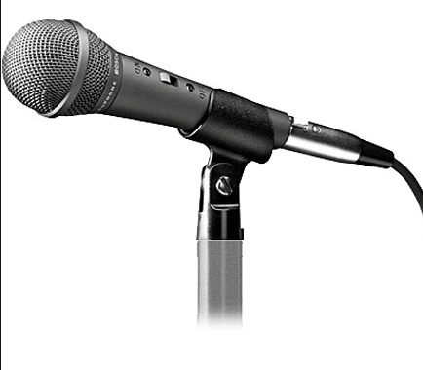

Why do we need Analog?
World is analog, unless you look at quantum levels
All signals by nature is analog
Some signal conditioning is done in analog before A-D
All processing in done in digital
Signal transmitted back to world in analog
An example

Slide 5
ELL 304 Course Structure
Class Timing F slot, Tu/W/F 11-12 pm.
Section-A WS-101 (G1-G4), Instructor : Rakesh Palani
Section-B VI-LT1 (G5-G8). Instructor : Ankesh Jain
Tutorial:
LH 613: 1-2 pm, Mon G1-G2, Tue G3-G4
LH 602: 1-2 pm, Thu G5-G6, Fri G7-G8
Lab :
II 401: 2-5 pm, Mon G1-G2, Tue G3-G4
II 401: 2-5 pm, Thu G5-G6, Fri G7-G8
Reference:
Behzad Razavi, Design of Analog CMOS integrated Circuits

Slide 6
ELL 304 Grading
Lab: 40 points
There will be 6 labs
24 points is for report +viva and 16 points is Quiz on the lab
Tutorial: 10 points
Each Tutorial → one quiz and the best 10 Quiz will be counted
Assignment: 20 points
5 Assignments → Best 4 will be counted
Project: 10 points
Minor: 25 points
Major : 35 points
Theory:100 Points
Lab : 40 points
Total :140 points

Slide 7
ELL 304 Honor Code
Cheating in any form will incur serious penalities
Remember grading is relative
Found in any tutorial, lab or exams will result in 0 point
Remaining portion of the grade will be scaled by 50%
For eg found cheating once in tutorial 1
Your score = 0 in tut1 +0.5(score of remaining tutorials)
Report to DISCO, IIT Delhi
Second time cheating in tutorial say 5
Your score = 0 in tut1+ 0 in tut5 + 0.25(score of remaining tutorials)
We will trust you and we will try not to tempt you
Try not to place us in this unpleasant situation

Slide 8
Syllabus
Motivation to amplifiers
Need nonlinearity for amplification
Introduction to MOSFETs
Small signal approximation
Biasing
Current Mirror
Single stage amplifiers
Introduction to Differential pair
We will deal only with MOSFETs and not BJTs unless necessary

Slide 9
Some conventions
Highest potential is typ. power supply
Lowest potential is ground
Current flowing into element is positive
If Z is passive VI >0
If Z is active, eg battery VI<0
Voltages are typically measured wrt gnd
Its indicated as V₁ in the figure

Slide 10
Passivity
If the two port is passive
V₁I₁ + V₂I₂ >0
This cannot generate power
Input power P_{in} = V₁I₁
Output power P_{out} = -V₂I₂
P_{in} > P_{out}
Its evident that the
two port is lossy
It is passive
Output power is lower than Input power
Power amplification is not possible with passive network

Slide 11
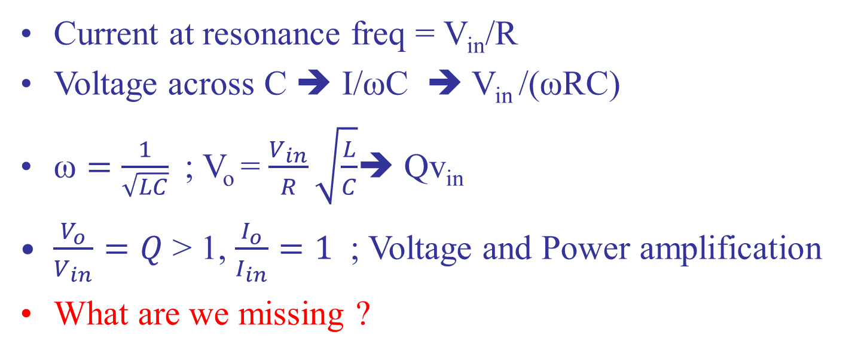
Puzzle - 1
Current at resonance freq = V_{in}/R
Voltage across C ➔ I/ωC ➔ V_{in} /(ωRC)
$\text{ω}=\frac{1}{\sqrt{LC}}$; V_{o} = $\frac{V_{in}}{R}\sqrt{\frac{L}{C}}$➔ Qv_{in}
$\frac{V_{o}}{V_{in}}=Q$ > 1, $\frac{I_{o}}{I_{in}}=1$ ; Voltage and Power amplification
What are we missing ?

Slide 12
Need for nonlinearity
Take the extra power from the Power supply Vdc
Convert this power to the power at input freq
Linearity
Superposition
Scaling
DC power will appear only at dc if network is linear
Non linearity is needed for power amplification
V₁ =Asinωt ; V₂ =kAsin(ωt+φ) ; k>1
Dc power has to be translated to frequency ω

Slide 13
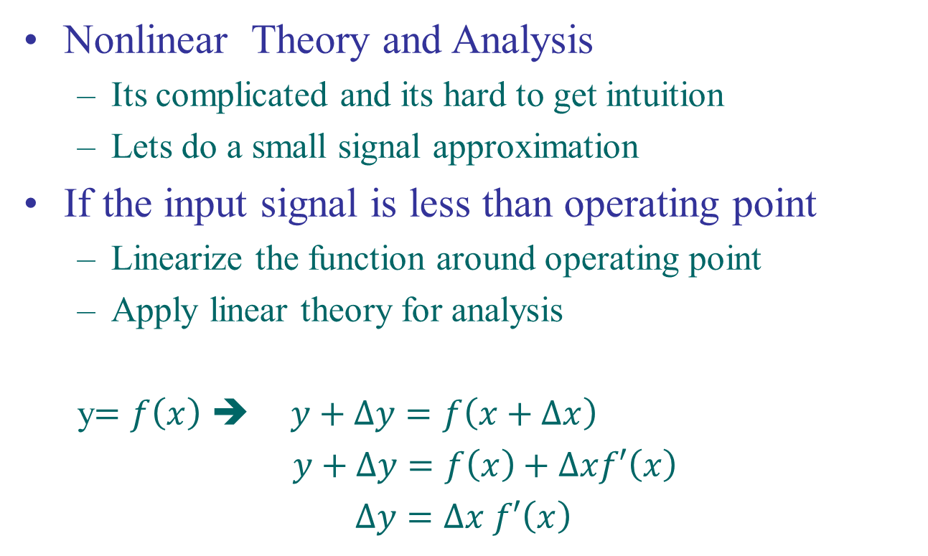
Small Signal Analysis
Nonlinear Theory and Analysis
Its complicated and its hard to get intuition
Lets do a small signal approximation
If the input signal is less than operating point
Linearize the function around operating point
Apply linear theory for analysis
y$=f\left(x\right)$ ➔ $y+∆y=f\left(x+∆x\right)$
$y+∆y=f\left(x\right)+∆xf′\left(x\right)$
$∆y=∆x f′\left(x\right)$

Slide 14
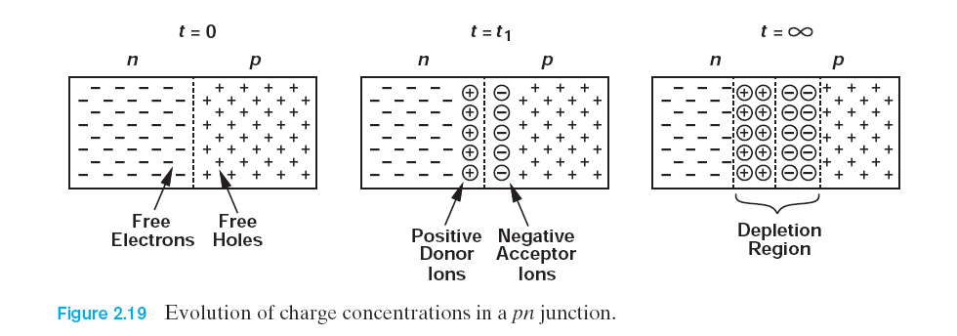
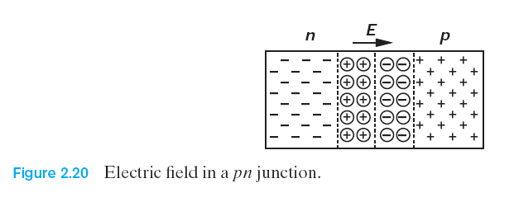
Introduction to Diodes
PN Junction
Needed for rectifiers to charge battery in cell phone
This is the simplest architecture to study
If the junction formed at t=0.
Equilibrium is reached
Electric field stops diffusion current

Slide 15
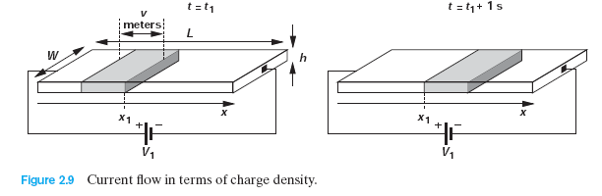
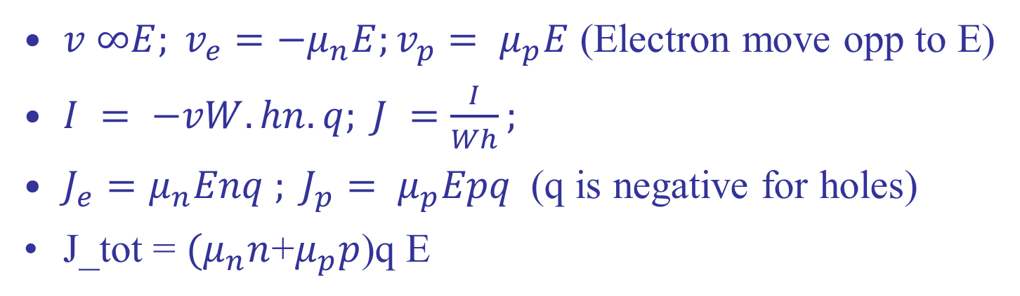
Drift and Diffusion current
$v ∞E; v_{e}=−μ_{n}E;v_{p}= μ_{p}E$ (Electron move opp to E)
$I = −vW.hn.q; J =\frac{I}{Wh};$
$J_{e}=μ_{n}Enq ; J_{p}= μ_{p}Epq$(q is negative for holes)
J_tot = ${(μ}_{n}n$+$μ_{p}p$)q E

Slide 16
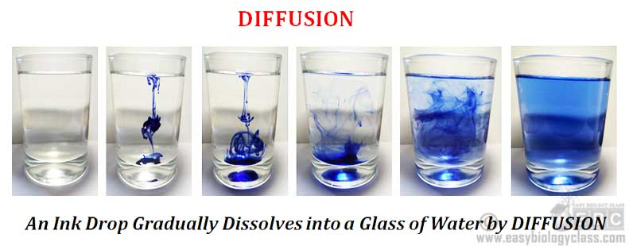
Diffusion current
Charge move from higher to lower concentration
Analogous to ink diffusing in a cup of water
*https://www.easybiologyclass.com/difference-between-diffusion-and-osmosis-a-comparison-table/

Slide 17
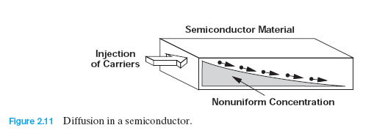
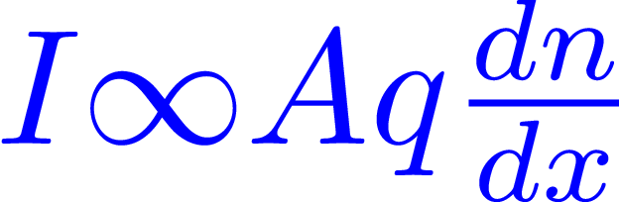
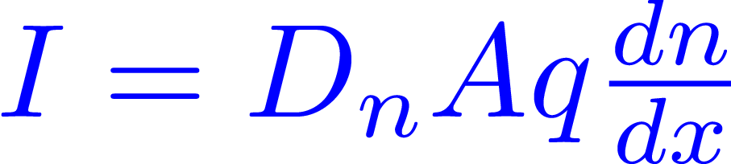
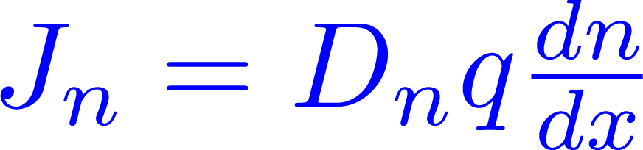
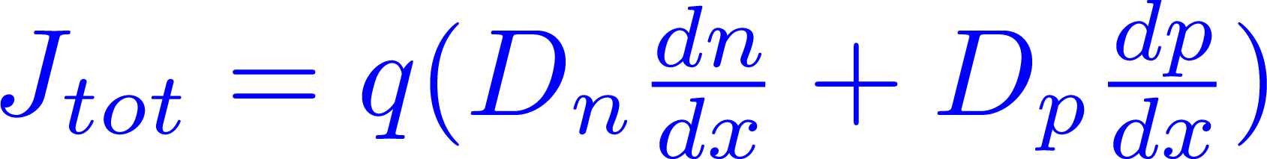
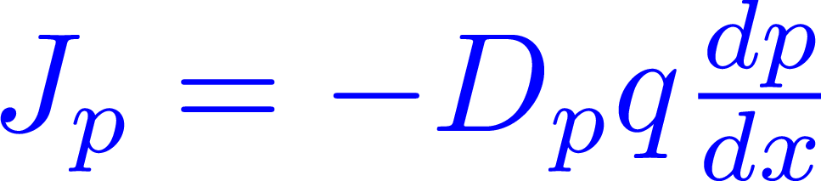
Diffusion current
Charge move from higher to lower concentration
Analogous to ink diffusing in a cup of water
A is cross section area, Q is charge and dn/dx is the gradient, D is the diffusion constant
*https://www.easybiologyclass.com/difference-between-diffusion-and-osmosis-a-comparison-table/

Slide 18
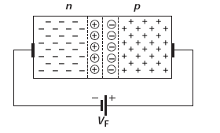
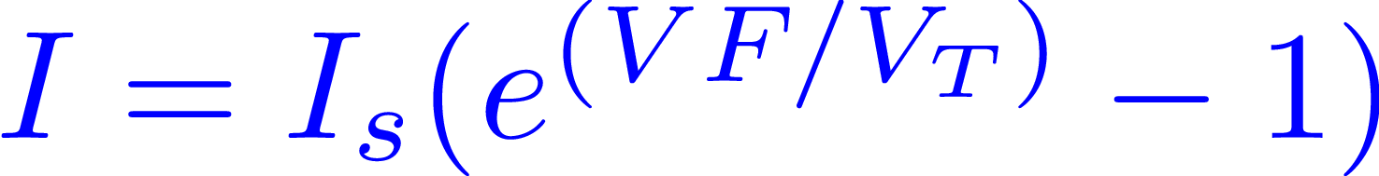
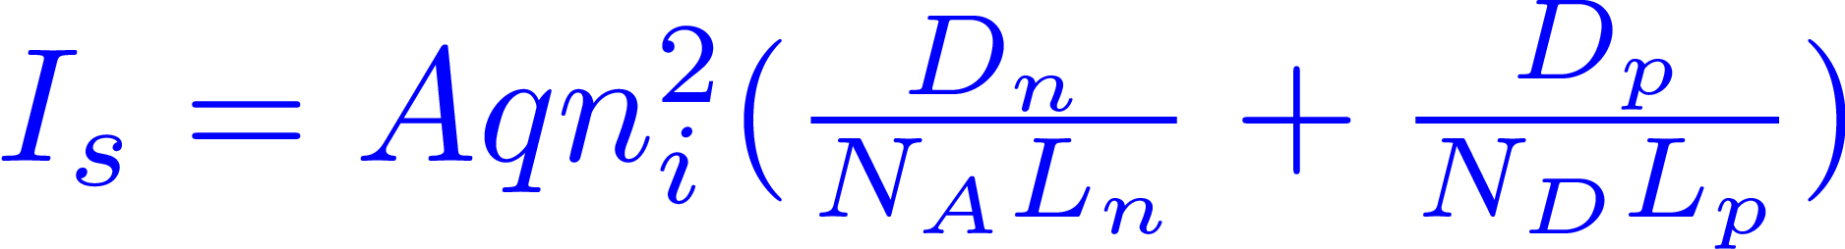
Diode Equation
For the derivations of diode equations refer
http://www.faculty.jacobs-university.de/dknipp/c300331/Lectures/4%20Diodes.pdf
Diode in Forward bias
Where L_{n} and L_{p} are electron and hole diffusion length
For course we just need this eqn

Slide 19
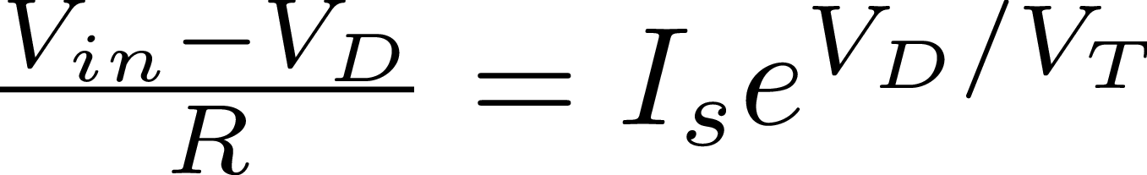
Small Signal Analysis: Motivation
We need to find I_{D}
I_{D} is a function of V_{in}
Need to solve this nonlinear equation with Vin
Quite cumbersome
LHS is red, RHS is blue
Point of intersection is solution
When V_{in} is changed by δ, red curve is shifted
Actual solution involves solving this non linear equation again

Slide 20
Small Signal Analysis: Motivation
We need to find I_{D}
I_{D} is a function of V_{in}
Need to solve this nonlinear equation with Vin
Quite cumbersome
Linearize around operating point
Find the approximate solution
Accuracy depends on the value of δ

Slide 21
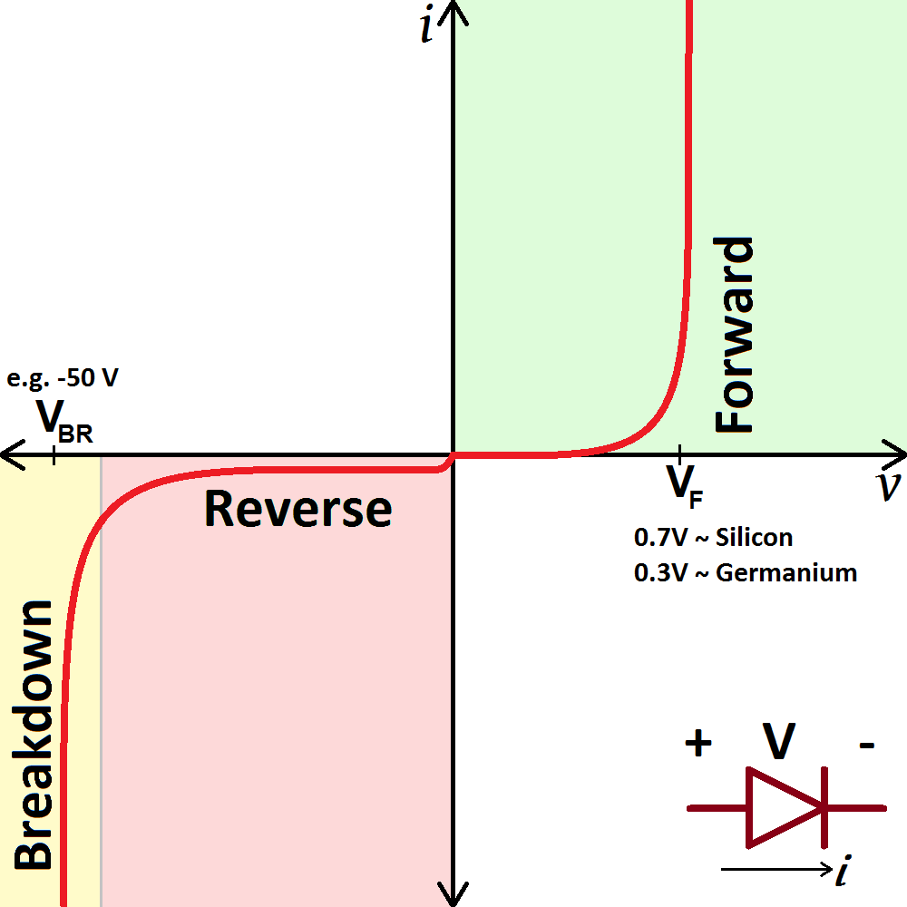
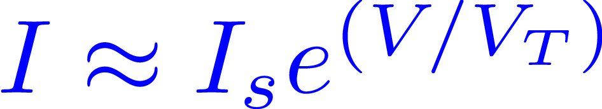
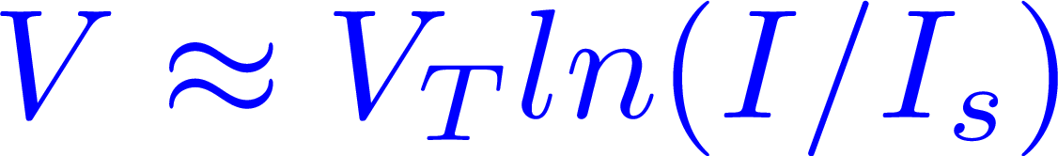
Some Approximations
Approximations
Forward bias
V>V_{T} ,
Voltage across diode is pinned to VF
If I changes by 2x, V ~V_{T} ln(2) ➔18mV
Operating voltage ~700mV
Diode Voltage ~700mV for all currents
Reverse Bias
Current is ~Is << Forward bias current
Current is approximated to zero

Slide 22
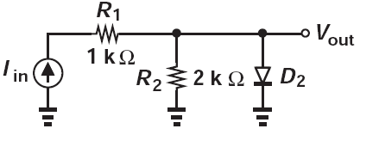
Example -1
I_{in} = 3mA.
A sinusoidal signal of 100u(sinwt) is applied with I_{in}.
Calculate the amplitude of sinusoidal wave at V_{out}?
Assume diode drop is 0.8V

Slide 23
Example -1
Operating point at V_{out} is 0.8V (diode drop)
Current is diode is 2.6mA and R₂ is 0.8/2k =0.4mA
Small signal diode res. is V_{T}/I_{d2} = 26m/2.6m =10 ohm
Vout = 100usin(wt) * (2k||10) ~ sin(wt) mV

Slide 24
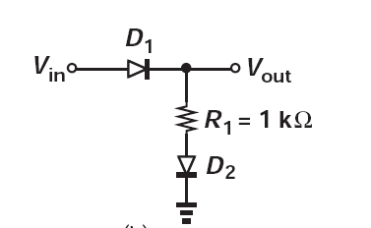
Example -2
V_{in} = 4.2V.
A sinusoidal signal of sinwt is applied with V_{in}.
Calculate the amplitude of sinusoidal wave at V_{out}?
Assume diode drop is 0.8V

Slide 25
Example -2
I =(vin-1.6)/1k =2.6mA
Small signal diode res. is V_{T}/I_{d2} = 26m/2.6m =10 ohm
Vout = sin(wt) * (1010/1020) ~ 0.99sin(wt)

Slide 26
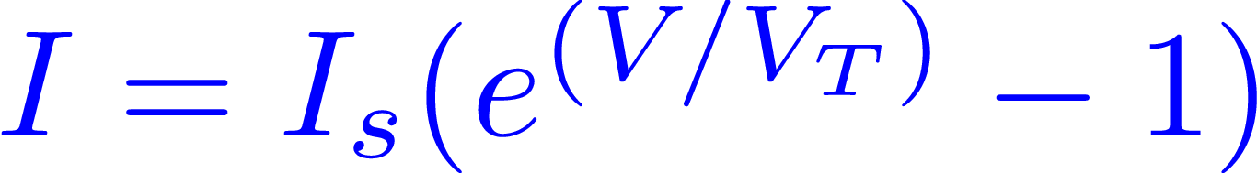

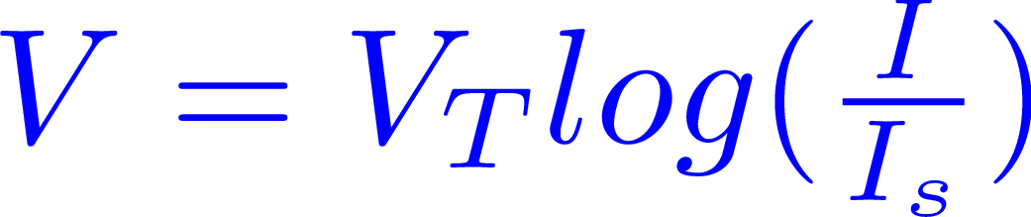
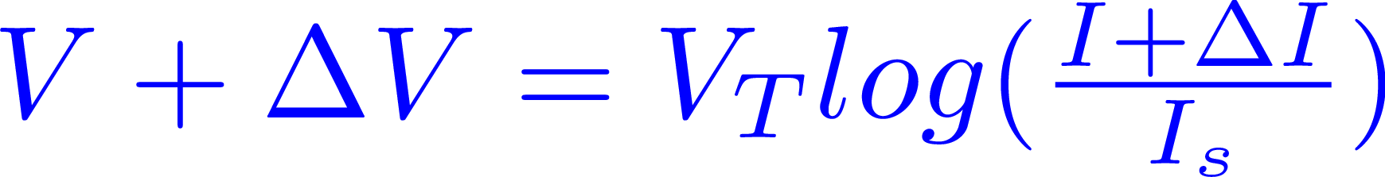
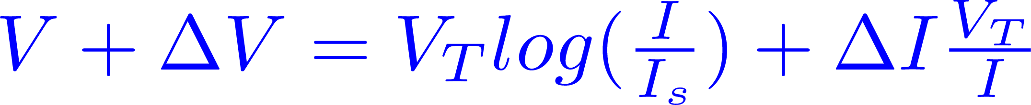
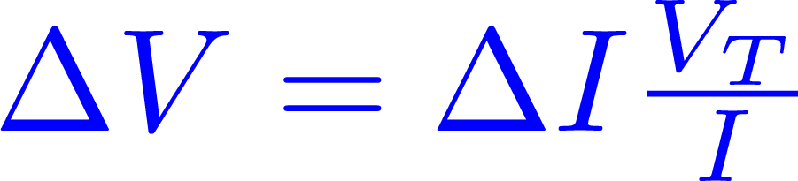
Small Signal equivalent
1 ensures passivity, if V=0 ➔I=0
If diode is forward biased e^{(V/VT)} >>1
or
Expanding in Taylor series,
V_{T} is thermal voltage (kT/q) ~ 26mV @27C
Small signal Equivalent of diode is a Resistor of value V_{T}/I

Slide 27
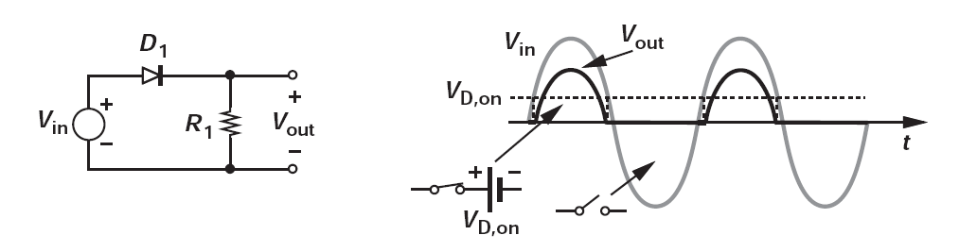

Diode
Applications
Half wave and Full Wave Rectifier
Limiting Circuits
Voltage Doublers
Level Shifters
Not going through details of these applications in this course. Ref chapter 3 in Text book if you want to learn more

Slide 28
Diode as Logic gate
AND/OR Gate are possible with diodes
But inversion is not possible
Current increases with applied voltage
Hence universal gates not possible
We need a device where increasing voltage reduces current.
Means a negative resistance in 1 port (not possible)
we need 2 port where voltage reduces current in other port
Three terminal device needed

Slide 29
Summary
Amplification
We need Non-Linearity
Small Signal Analysis
Linearize IV characteristics near operating point
Use Linear theory
Diode
Two terminal device
Current flows only in one direction
Small signal Equivalent is a resistor
NOT gate is not possible using diodes
Three terminal device
Uses P_{DC} to amplify P_{IN}

Slide 30
Introduction to Two port
Two port Model
Three terminal Two port Model
Ideally two port network has separate terminals for input and output
For amplifier design we have one terminal common
For simplicity
Three terminal two port model

Slide 31
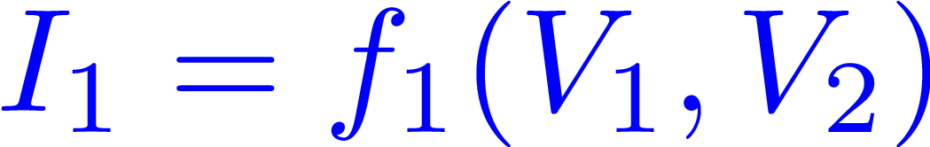
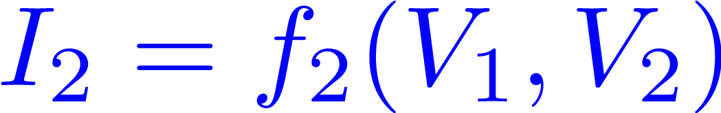
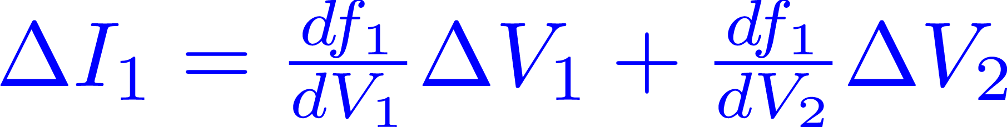
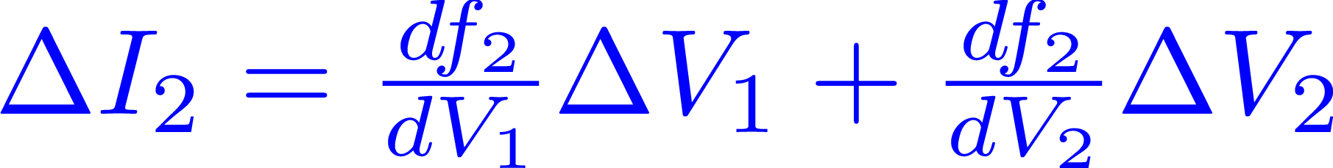
Three terminal Two Port
Three terminal Two port Model
Apply the same small signal analysis
Change in V₁ and V₂ by ∆
Evaluated at operating points

Slide 32
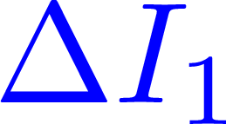
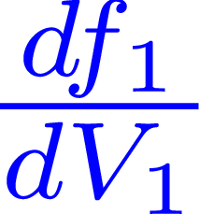
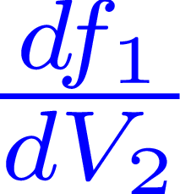
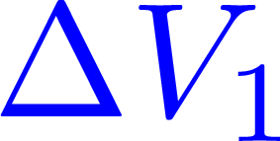
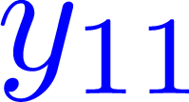
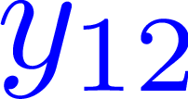

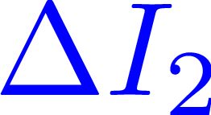
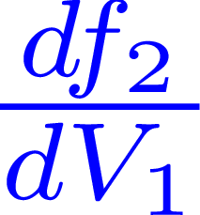
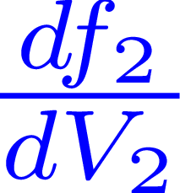
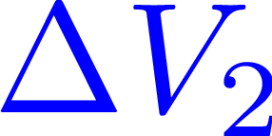
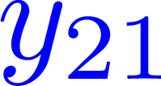
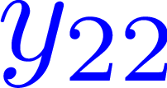
Three terminal Two Port
Three terminal Two port Model
Apply the same small signal analysis
Change in V₁ and V₂ by ∆
Unit of conductance
Evaluated at operating points

Slide 33
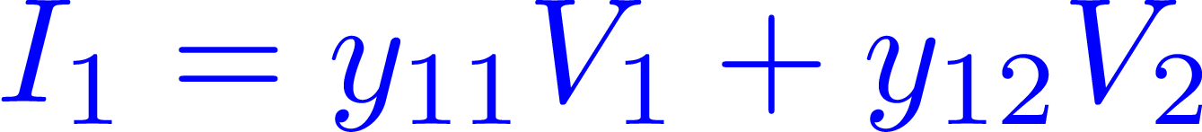
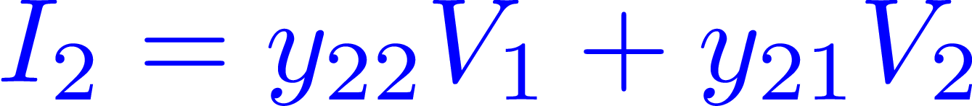
Three terminal Two Port
Three terminal Two port Model
y₁₁- Effect of port 1 on port 1
y₁₂- Effect of port 2 on port 1
y₂₂- Effect of port 2 on port 2
y₂₁- Effect of port 1 on port 2
I_{1,} I₂ and V_{1,}V₂ are small signal parameters

Slide 34
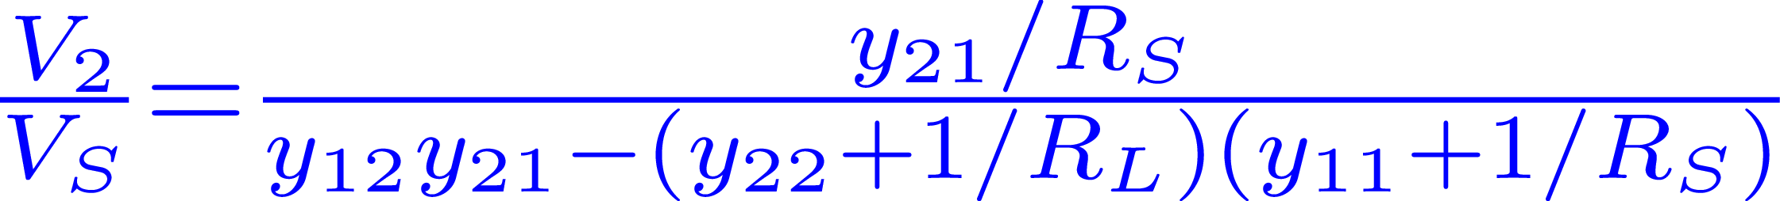
Condition for maximum gain
Source has output impedance of R_{S} and load is R_{L}
Gain =
Maximize y₂₁
Minimize denominator
y_{22,} y₁₁ are positive conductances, min =0
Y₂₁ is the effect of V₂ on I₁. Looks positive feedback
Y₁₂ =0 to get unconditional stability

Slide 35
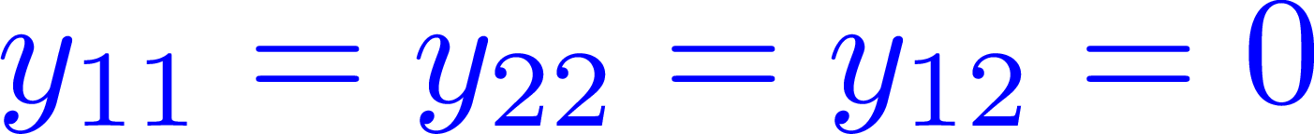
Condition for maximum gain
1.
2. Maximize y₂₁
Y₁₁ = 0; Input loading =0
Y₂₂ = 0; Output loading =0
Y₁₂ = 0; Breaks feedback
Y₂₁ ; Converts input voltage to output current, maximize

Slide 36
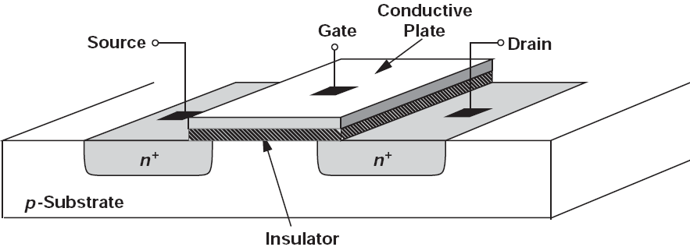

Introduction to MOSFETs
MOSFET Structure
Its basically a capacitor
When gate potential is zero
Channel has holes
The channel between source and drain is cut off
When gate potential is high
Electrons are attracted to surface forming a channel

Slide 37
N-MOSFET
It’s a 4 terminal device (NMOS)
Channel is n-type, bulk is p-type
Assume bulk is connected to lowest supply
We will deal with bulk little later
Gate is a high impedance node, I_{G} ~ 0
I_{G} ~ 0
Source and Drain is interchangeable
Symbol

Slide 38
P-MOSFET
It’s a 4 terminal device
Channel is p-type, bulk is n-type
Assume bulk is connected to highest supply
We will deal with bulk little later
Gate is a high impedance node, I_{G} ~ 0
I_{G} ~ 0
Source and Drain is interchangeable
Symbol

Slide 39
MOSFET Equations (NMOS)
MOSFET is on
V_{GS} >V_{T}
V_{T} is the threshold voltage
V_{GS} > V_{T} ; V_{GD} <V_{T} ; (Saturation Region )
V_{GS} > V_{T} ; V_{GD} >V_{T} ; (Linear Region )
MOSFET Structure
For derivations refer chapter 6 in Text book

Slide 40
MOSFET Equations (PMOS)
MOSFET is on
V_{GS} >V_{T}
V_{T} is the threshold voltage
V_{SG} > V_{T} ; V_{DG} <V_{T} ; (Saturation Region )
V_{GS} > V_{T} ; V_{GD} >V_{T} ; (Linear Region )
P MOSFET
For derivations refer chapter 6 in Text book

Slide 41

I_{d}-V_{GS} characteristics
Saturation Region
Vds =50mV -1.8V
Vds =50mV -1.8V
Linear
Region
Condition for Saturation
V_{GD} <V_{T,} V_{GS} >V_{T}
V_{G} –V_{D} < V_{T}
Drain can be lower than gate by a threshold voltage
VT ~ 450mV -1.8V
Here we do for NMOS
You will repeat it for PMOS in your lab -1

Slide 42

I_{d}-V_{DS} characteristics
Output impedance
Triode
Saturation
Vgs =100mV -1.8V
Condition for Saturation
V_{GD} <V_{T,} V_{GS} >V_{T}
V_{G} –V_{D} < V_{T}
Drain can be lower than gate by a threshold voltage
Sub-threshold
Here we do for NMOS
You will repeat it for PMOS in your lab -1

Slide 43
Lets revisit y parameter
We saw for maximal amplification
Y₁₁ = 0, Y₂₂ = 0, Y₁₂ = 0, Maximize (Y₂₁)
Input impedance of MOS is high, Y₁₁ = 0
If we ignore caps Y₁₂ = 0
MOS is gate controlled device
Condition for Maximal amplification

Slide 44

I_{d}-V_{GS} characteristics
Saturation Region
Y₂₁
Linear
Region
Condition for Saturation
V_{GD} <V_{T,} V_{GS} >V_{T}
V_{G} –V_{D} < V_{T}
Drain can be lower than gate by a threshold voltage
Y₂₁ increase
Maximize Y₂₁
Maximum Y₂₁ is obtained when the transistor goes to saturation region !

Slide 45

I_{d}-V_{DS} characteristics
Y₂₂
Triode
Y₂₂ ~0
Saturation
Condition for Saturation
V_{GD} <V_{T,} V_{GS} >V_{T}
V_{G} –V_{D} < V_{T}
Drain can be lower than gate by a threshold voltage
A MOSFET in saturation gives Y₂₂ ~0
It can be used as amplifier when biased here!

Slide 46
For maximizing gain
Gate current = 0
Output conductance = 0; gds =0
Maximize Transconductance; maximize gm
Y₁₂ =0; For unconditional stability
Transistor should be operated in saturation to satisfy these conditions

Slide 47

Small Signal Analysis
MOSFET
Drain current is a function of both gate and drain voltage
Lets find incremental current for small changes in V_{GS} and V_{DS}
Unit is conductance, but its port 2 current by port 1 voltage. So termed as transconductance
Unit is conductance, but its port 2 current by port 2 voltage. So termed as output conductance

Slide 48








Small Signal: Transistor (Saturation)
(Ignore λ for simplicity)
(gm in terms of W/L and overdrive)
(gm in terms of W/L and drain current)
(gm in terms of overdrive voltage and drain current)
(Mobility of electrons)
(Overdrive voltage, V_{dsat})
(Oxide Capacitance per unit area)
(How much gate voltage we have more than threshold)
(Gate width and Length)

Slide 49
Small Signal: Transistor (Saturation)
(Ignore λ for simplicity)
Slope is g_{m}, Maximize for higher gain

Slide 50
Small Signal: Transistor (Saturation)
(Ignore λ for simplicity)
Saturation
Slope is gds, Ideally we want to be zero

Slide 51


Small Signal Analysis (NMOS)
NMOS is in saturation
Summary
Transconductance different forms
Output conductance
Output impedance

Slide 52

Small Signal Analysis (Triode)
Condition for Triode
V_{GD} >V_{T,} V_{GS} >V_{T}
V_{G} –V_{T} > V_{D}
Drain voltage is lesser than V_{G}-V_{T}.
g_{m} is lower than g_{ds} for the transistor in triode
Gate has lower control than drain on channel
gds for transistor in triode is approx. same as gm of transistor in saturation.

Slide 53
Small Signal Analysis (Triode)
g_{ds,sat} < g_{ds,triode}
g_{m,sat} > g_{m,triode}
The slope is the gds

Slide 54
Small Signal Analysis
Gate has more control on channel (Saturation)
Drain has more control on channel (Triode)
Transistor in Triode
Is a resistor whose value depends on V_{GS}
Transistor in Saturation
Is a current source whose value depends on V_{GS}
g_{ds,sat} < g_{ds,triode}
g_{m,sat} > g_{m,triode}

Slide 55
Tutorial
Derive the small signal parameters for PMOS Transistor

Slide 56
Condition for maximum gain
1.
2. Maximize y₂₁
Y₁₁ = 0; Input loading =0
Y₂₂ = 0; Output loading =0
Y₁₂ = 0; Breaks feedback
Y₂₁ ; Converts input voltage to output current, maximize

Slide 57
Body Terminal
Body/Bulk terminal
Nmos
Bulk is connected to gnd
Pmos
Bulk is connected to highest supply
Forward biasing the bulk diode will reduce threshold voltage
This is sometimes considered as back gate
Small signal approximate current is g_{mb}V_{bs}

Slide 58
Small Signal Model (dc)
Gate is a high impedance node. Y₁₁ ~0.
Voltage controlled current source (g_{m}V_{gs}) = Y₂₁ V_{gs}
Output conductance g_{ds.} Y₂₂ = g_{ds.} Ideally zero
There is no Y_{12.}
Small Signal Model of MOS to be used as amplifier

Slide 59





MOSFET Capacitors
Capacitances from every node to every other node
C_{GS} and C_{GD} are the gate to source and drain capacitors
They consist of overlap capacitor
C_{DB} and C_{SB} are the reverse bias junction caps
Transistor in Saturation
Transistor in Triode

Slide 60
Biasing
MOSFETs has to be biased
In saturation to be used as amplifier
In Triode to be used as resistor
Biasing
Constant voltage biasing
Constant current biasing
Constant trans-conductance (gm) biasing
So on…

Slide 61
Why biasing is important
Constant Voltage Biasing
Lets say transistor V_{gs} is always V_{b}
If V_{T} changes by ∆V_{T}
∆I_{ds} will be large due to expansive nature
The transistor Id-Vgs is expansive in nature
This feature gives gain
The transistor threshold voltage, temperature, process corners etc can create a change in the charactristics

Slide 62
Why biasing is important
Constant Current Biasing
Lets say transistor V_{gs} is always V_{b}
If V_{T} changes by ∆V_{T}
∆V_{gs} will be small due to expansive nature
Typically transistors are biased using constant current in all amplifiers

Slide 63



Const. Voltage biasing
The resistor Rs reduces the sensitivity of I_{ds} with the threshold voltage

Slide 64

LT Spice Schematic

Slide 65

LT Spice Results
Variation reduced from 40% to 27%

Slide 66



Self-Bias

Slide 67
Single Stage Amplifiers

